Slide 1
Identify business opportunities through clustering

Slide 2
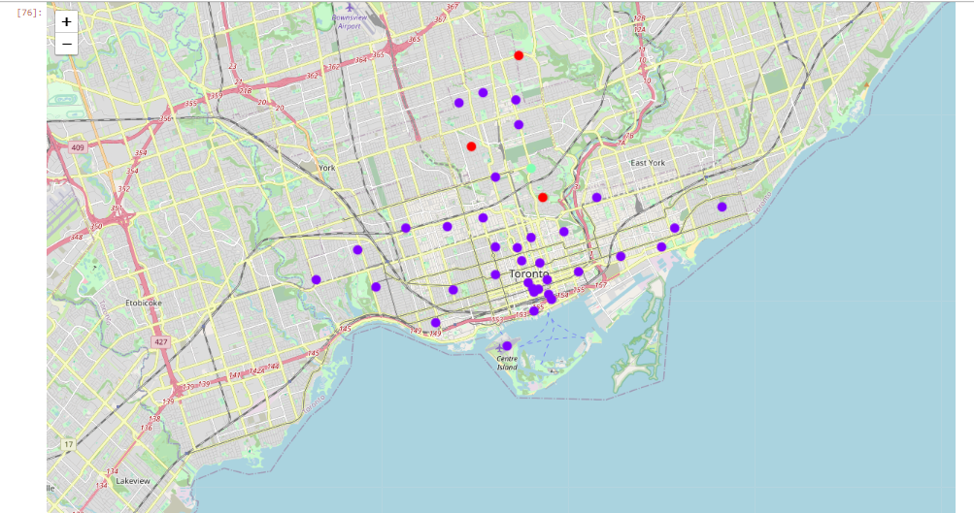
Trade map of Toronto

Slide 3
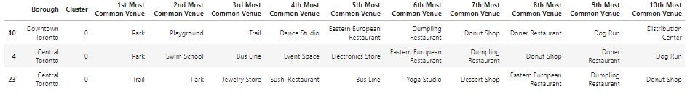
Cluster 0

Slide 4
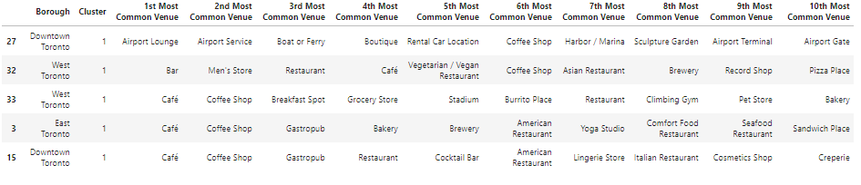
Cluster 1

Slide 5
Cluster 2

